Slide 1

A Deeper Dive Into
NFL Data

Slide 2
The Data We Explored
Utilizing the NFL Data from Project 1: NFL Teams data, NFL stadiums/weather data and NFL betting data showing over/under line and game spread.
NFL Injury data: python library containing injury data including season, player, position and status before the game from 2009 to 2022
NFL Penalties data: detailing penalties for each game showing the quarter, player and time during the game from 2009 to 2022.
NFL Draft data: python library including draft picks and rounds for each NFL team from 2009-2022.

Slide 3
Unlocking Insights: A Journey into the NFL Data
Using the injury data set, we want to determine how a team’s overall record could be impacted by injuries to key players on their team. Which injuries had the highest impact on a team’s outcome?
With access to the NFL penalty data set, we want to see how penalties impact the overall outcome of a game. How many games were decided by a late penalty?
Using the draft picks data set and seasonal nfl data set showing player career stats, we have an exploratory interactive chart to examine the differences between players efficiency based on position and their corresponding draft rounds.

Slide 4

NFL Injury Predictions
Analytic approach for predicting injuries
**RIP Chubb**

Slide 5
Injury Analysis Overview
Data Factors in Considerations:
Effects that playing on synthetic vs natural turf
Factors such as stadiums, weather, play type and player position
250 complete player in-game histories from two subsequent NFL regular seasons.

Slide 6
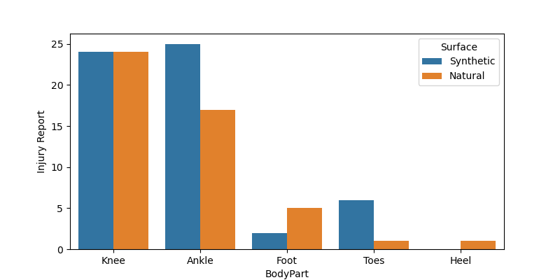
Does Turf has impact on injury based on play type and player positions?
Notes:
Injuries shown that was abstained based on the lower parts of the body, where the Knee and Ankle are showing the most impact injuries however for the knee it’s displaying where injuries are impacted significantly with synthetic turf.

Slide 7
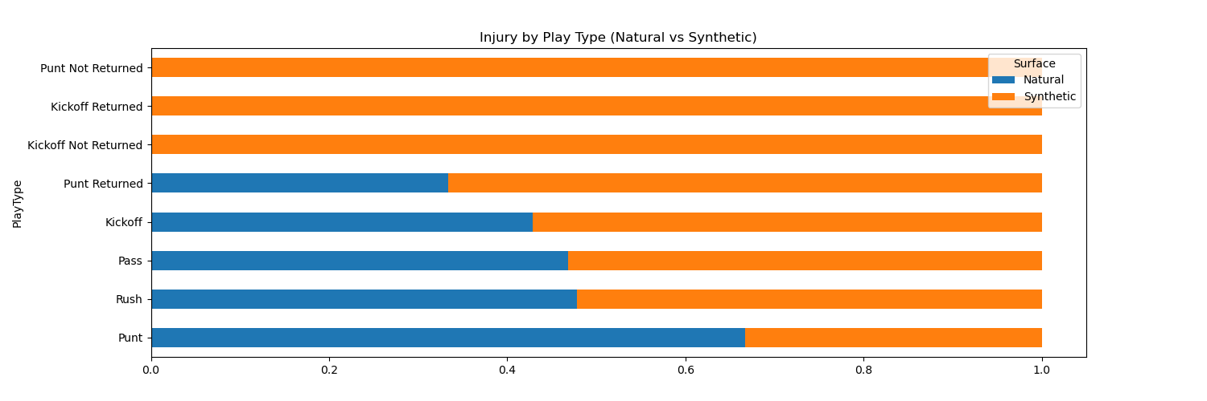
Notes:
Result displaying synthetic grass type have significant injuries by play type with punt not return, kickoff return, and kick-off not returned has most sustained injuries.

Slide 8
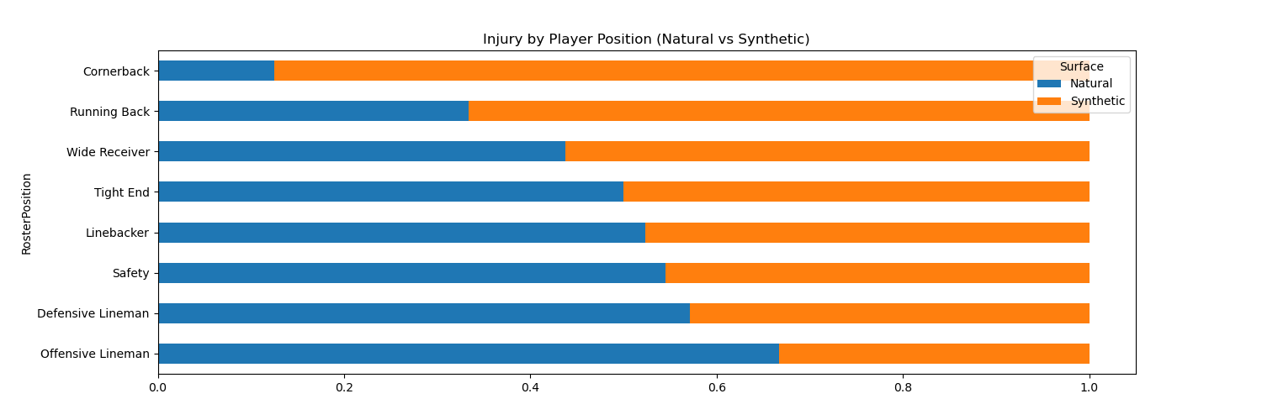
Notes:
With comparison with player position shows more injuries sustained from natural grass but less with synthetic grass

Slide 9

Questions we’ve ask ourselves:
--What is likely the risk of a player’s injury based on turf type?
--Is the Predictions of Injuries Accurate?
--Does the importance of grass type impact injuries?

Slide 10

The Solution….. Data Hazard Model
Kaplan-Meier Estimate (Curve)
Confusion Matrix (Logistic Regression)
Random Forest Classifier
Notes:
Links to the sources

Slide 11
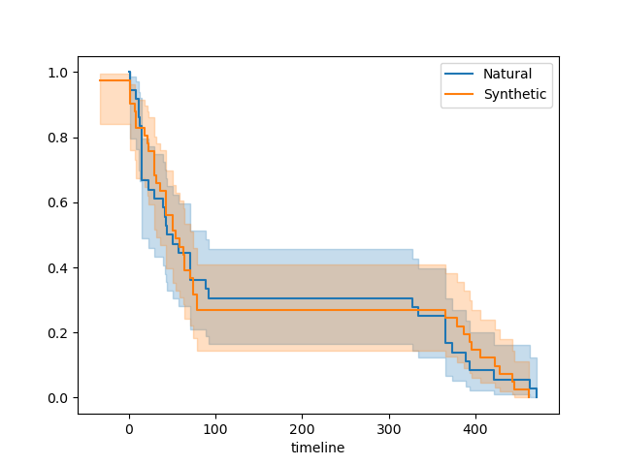
Kaplan Meier Curve
Question: What is likely the risk of a player’s injury based on turf type?
Answer: both curves indicated with both significant risk of injuries
Notes:
Model to predict the injuries uses to analyze injury occurred over period of number of days played.
Compared two curves for both natural and synthetic grass types
Results shown that for both curves showing an increase likelihood of injuries occurring shown in the steep hill.
Based on the pattern of this curve shows synthetic curve shows a small margin of .05 which indicated more injury risk for the synthetic than natural grass,

Slide 12
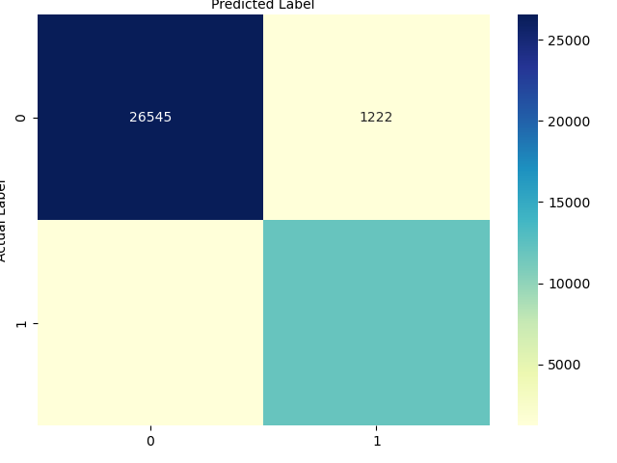
Logistic Regression…also known as confusion matrix
Question: is the predictions of the injuries accurate….?
Answer: No…. the model suggested that the prediction model is inaccurate
Notes:
Regression uses an binary values such as yes, no or true, false to predict the outcome
The confusion matrix is a N x N matrix, where N is the number of classes or outputs.
True Positive (TP) : predicted(1), actual(1)
False Positive (FP) : predicted(1), actual(0)
True Negative (TN) : predicted(0), actual(0)
False Negative (FN) : predicted(0), actual(1)
The data shown with 26545 as false negative and 1222 False Positive which means that the prediction of this data is incorrect and inaccurate

Slide 13
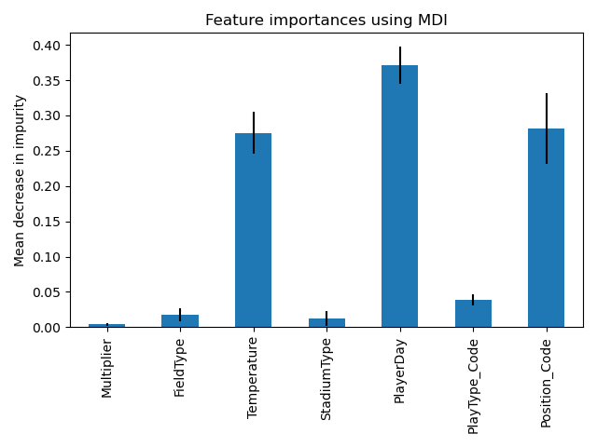
Random Forest Classifier
Question: Does the importance of the grass type affect the injury?
Answer: No….shows that grass types does not impact players injuries
Notes:
Used to evaluate the importance of each feature (or factors that contribute to injuries based on previous predictive model)
Results show that three features temperature, Player Day and Position are shown to have three significant importance which factors the injury.
Interesting part shown as Field Type showing no significant importance impacting the injury prediction.

Slide 14
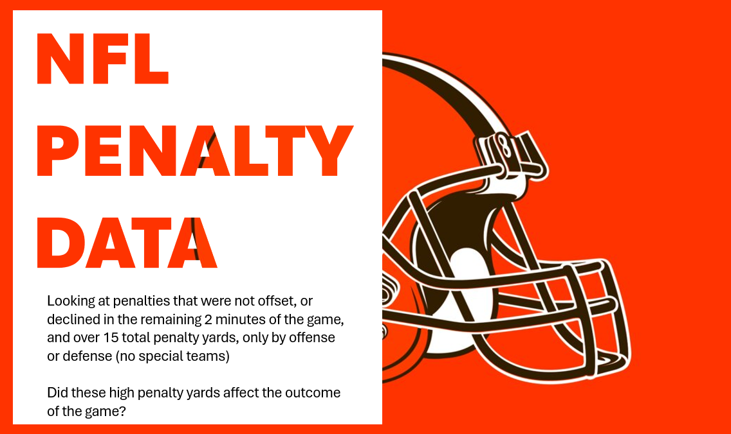

Slide 15
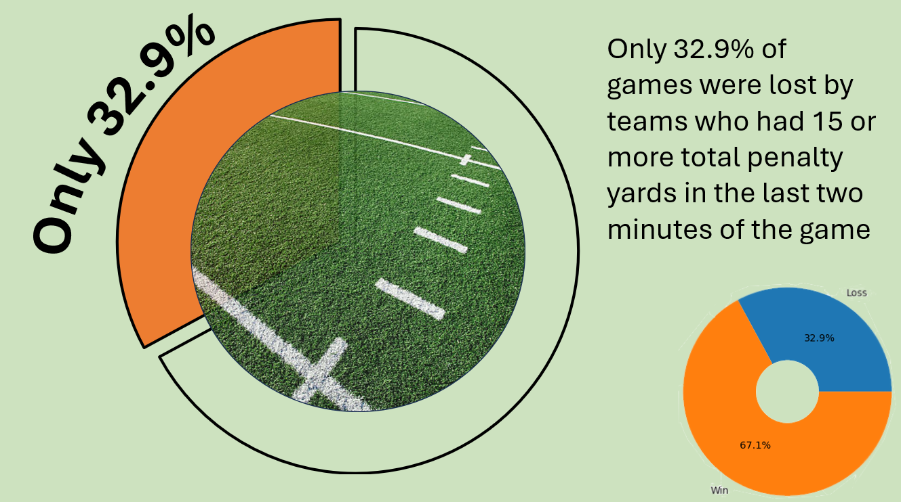

Slide 16
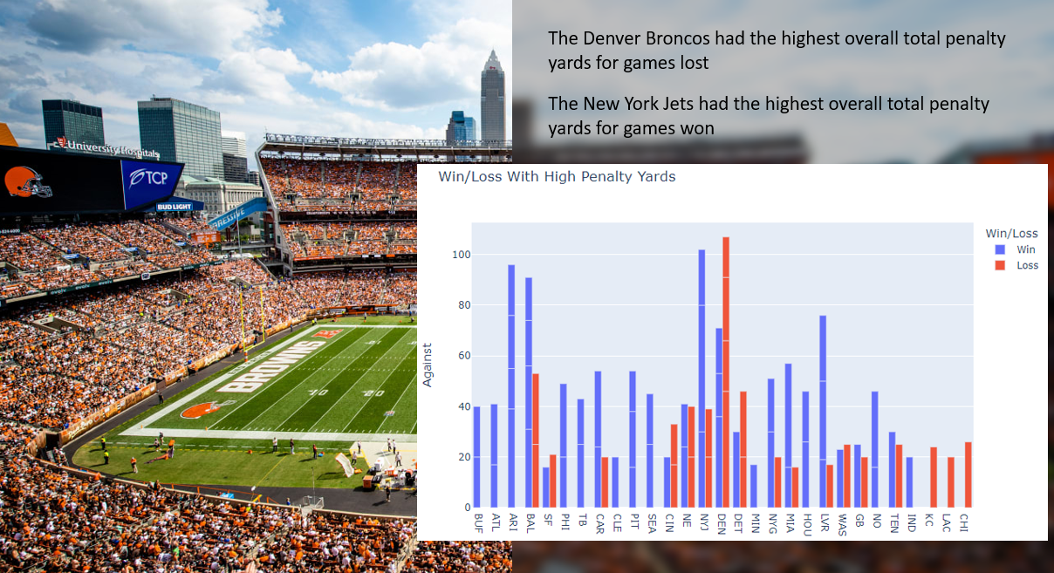

Slide 17
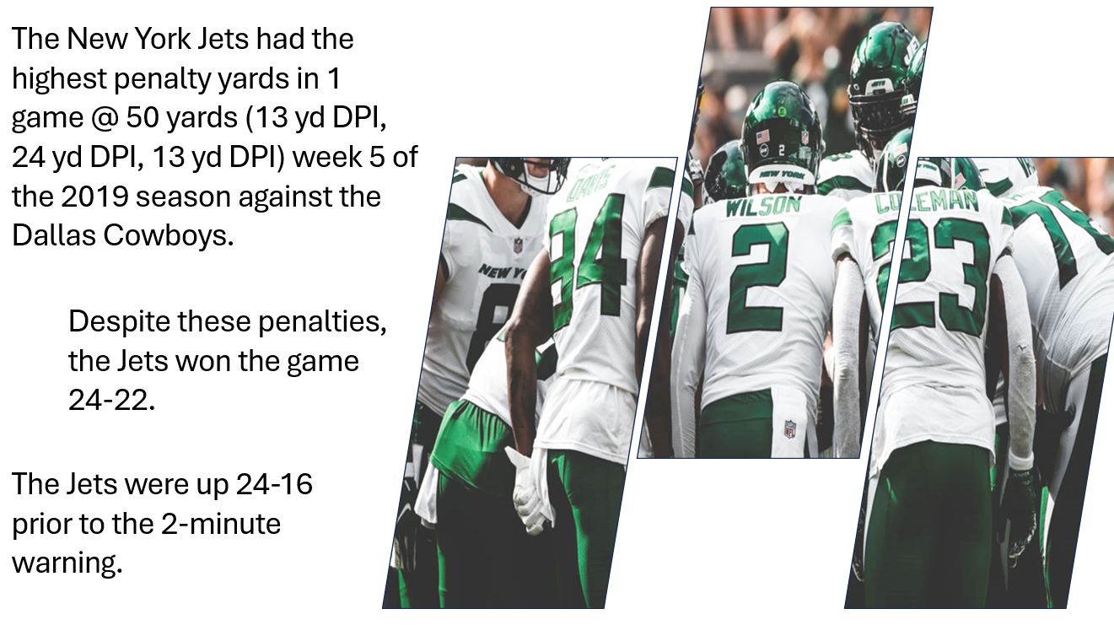

Slide 18

NFL Draft Data Interactive Chart
Features:
Sort by Minimum Number of games played
Sort by Season year or range of seasons
Sort by number of pro bowls received
Sort by Position
Filter Y-axis by passing, rushing, receiving efficiencies or PPR fantasy points
Details:
4173 total data points
960 total Unique Players
Looking only at Qb’s, RB’s, WR’s and TE’s
Seasons 2009 to 2023
Regular Season Stats

Slide 19
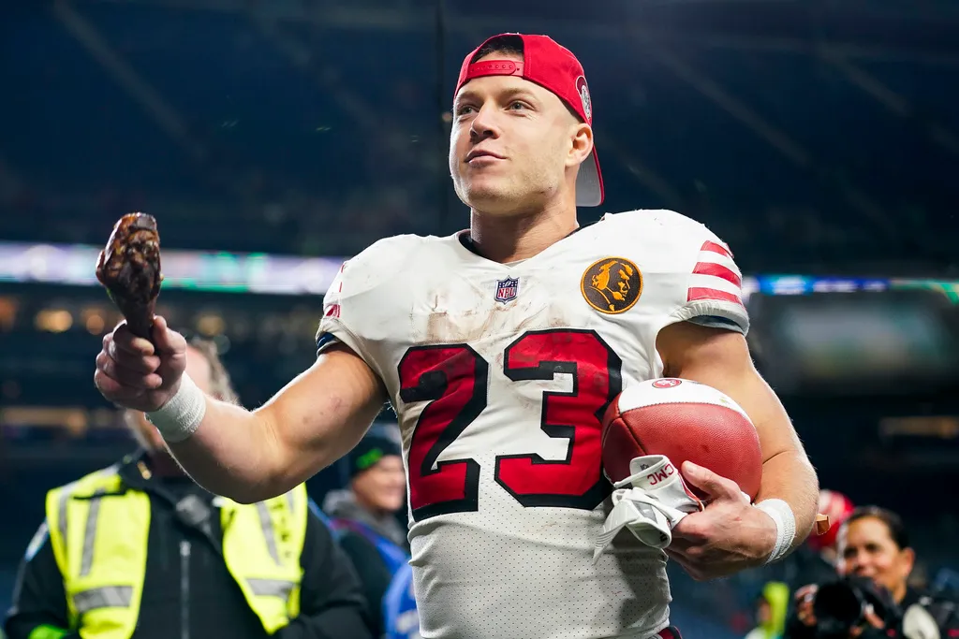
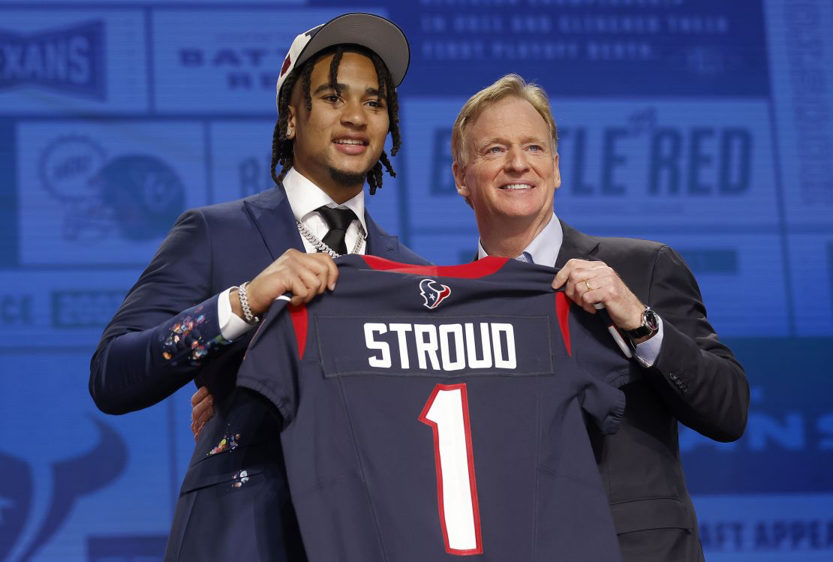
Results from Exploratory Analysis
Early round draft picks tend to have more games played than later round picks
Early round draft picks tend to be more inconsistent when it comes to efficiency numbers but generally show a higher average efficiency than later round picks
QB’s taken in the first round show a significantly higher range of efficiency and 5th round QB’s appear to be very inefficient when it comes to contributing to their team
Looking at RB’s and WR’s.. the round they were selected in did not appear to significantly impact their efficiency suggesting it would be smart to draft a RB or WR any round and they could show potential.
The best time to draft a TE appears to be the second or third round.

Slide 20
Questions?

